Slide 1




IT Tickets Analysis &
Agent Performance Dashboard
Excel-based Analytical Project
Vaishnavi Pandey

Slide 2

Problem Statement
You are tasked with analyzing the IT support ticket management system to understand the performance of IT agents, the efficiency of ticket resolution, and the satisfaction levels of employees. The objective is to identify high and low performers among IT agents, assess the overall effectiveness of the team, and pinpoint areas for improvement in the ticket resolution process. The ultimate goal is to make informed staffing decisions, including hiring, firing, and training, to enhance overall service quality and team performance.

Slide 3
Dataset Structure
Data Overview
Datasets Used
Tickets Sheet: 97,498 records with attributes like ID Ticket, Fecha, Employee ID Agent ID, Request Category, Issue Type, Severity, Priority, Resolution Time (Days), Satisfaction Rate.
Tickets
97,498
Agents
50
IT Agents Sheet: 50 agents with demographic info (Agent ID, Full Name, Year of Birth, Month of Birth, Day of Birth)
Data Cleaning & Preprocessing:
Fixed spelling inconsistencies: "Mayor" → "Major", "Mid" → "Medium", etc.
Confirmed no missing values in any column
Why This Data is Critical:
Offers full-cycle visibility from ticket assignment to resolution
Enables agent-level productivity analysis
Identifies bottlenecks, underperformance, and satisfaction drivers Supports KPIs for both operational and strategic planning
Data Attributes
TIME SPAN
5 Years (2016-2020)
20 Quarters Complete data
lifecycle
Data Quality
No missing values
Standardized categories
Consistent naming

Slide 4
Methodology
Visual Elements
Techniques Used:
Bar Chart
Line Chart
Functions: AVERAGE, VLOOKUP, IF, INDEX/MATCH, TEXT, RIGHT, LEN, FIND. ARRAY
Pie Chart
Pivot Tables: Built for category-wise volume, agent KPIs, trend charts
Combo Chart
Scatter Plot
KPI Cards
Age Calculation: Derived from DOB using TODAY() and DATE()
Custom Grouping: Created Age Buckets with nested IF & ARRAY
Interactive Elements
Purpose:
Discover patterns in performance
Analyze agent efficiency across demographics
Build decision-ready dashboard for management
Support data-driven investment decisions
Dynamic Slicers & Timeline:
Year
Priority
Severity
Category

Slide 5
Category Vs Average Resolution Time{days}
Key Insight:
Hardware issues are the most time-consuming, taking an average of 7.6 days to resolve.
Login Access problems are resolved with exceptional speed, averaging just 0.3 days.
There's a major efficiency gap: Hardware tickets take 25 times longer to close than login access requests.
Hardware and System tickets represent the biggest opportunity to improve our average resolution time.

Slide 6



Ticket Category Distribution
Key Insight:
System and Login Access issues contribute to nearly 70% of all tickets, making them the biggest workload drivers.
These areas are prime for automation and process improvements, which can reduce volumes and ease agent workload.
Category wise Ticket Volume
Recommendations
Assign
Dedicated Sub-teams
For high-volume categories
Automate
Login Access Requests
Self-service portal & password reset
Monitor
System Stability
Implement proactive monitoring tools

Slide 7
Severity Wise Ticket Volume
Key Insight:
The vast majority of our ticket volume (90.93%) is classified as 'Normal' severity.
High-priority tickets ('Urgent' and 'Major') collectively represent only 6.4% of the total workload.
'Urgent' issues are the rarest ticket type, accounting for just 1.43% of the total volume.
A small percentage of tickets (0.37%) are 'Unclassified', pointing to an opportunity for better ticket triage.

Slide 8
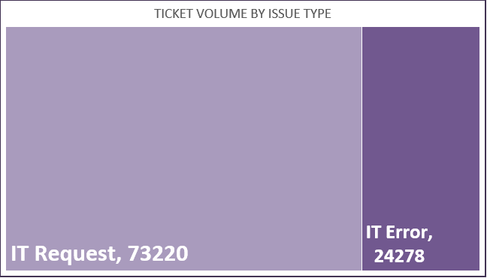
Ticket Volume By Issue Type
Key Insight:
IT Requests drive the majority (75%) of our ticket volume.
IT Errors or break-fix issues account for only 25% of tickets.
We receive three service requests for every one error report.
This data shows our team's primary focus is service fulfillment, not just fixing errors.

Slide 9
Ticket Volume Over Time
Key Insight:
Business Impact:
Rapid growth signals rising dependency on IT systems
Indicates need for scalable support, better tools, or ticket triaging
Year-wise Ticket Volume
13,051
2016
14,915
2017
+14.28% YoY
18,954
2018
+27.08% YoY
21,490
2019
+13.38% YoY
29,088
2020
+35.36% YoY

Slide 10
Average Resolution Time(days)
Key Insight:
Performance has remained stagnant for five years, showing no clear improvement.
Resolution times are highly volatile, with significant fluctuations every quarter.
We are consistently unable to break below the ~4.50 day performance floor.
This long-term trend proves our current processes are not driving efficiency.

Slide 11
Average Satisfaction Rate
Key Insight:
There is a clear, positive upward trend in customer satisfaction over the past five years.
Satisfaction scores reached an all-time high in 2020, peaking near the 4.20 mark.
A major growth period in 2016 successfully pushed our average score above the 4.0 milestone.
This sustained growth confirms our strategies are effectively improving customer satisfaction.

Slide 12
Distribution Of Tickets Based On Resolution Time
Key Insight:
Over half of all tickets (53%) are resolved in under 4 days.
The vast majority of our tickets (82%) are closed within the first 8 days.
Long-term tickets are rare outliers, with less than 1% taking over 16 days.
This distribution shows a highly efficient "quick to close" support model.

Slide 13
Distribution Of Tickets Based On Satisfaction Rate
Key Insight:
Over 52% of all tickets received the highest possible satisfaction score of 5.
The vast majority of feedback is positive, with over 80% of tickets rated a 4 or 5.
Customer sentiment is highly polarized, with very few neutral or mildly negative ratings.
Dissatisfied customers are 5 times more likely to rate a '1' than a '2', indicating strong opinions.

Slide 14
Age Group Wise Ticket Volume
Key Insight:
41–50 age group dominates with the highest ticket volume (16,322), showing heavy system reliance.
30–41 group also high (12,089), reflecting their balanced workload and key operational role.
<30 and 50+ groups handle fewer tickets, possibly due to limited experience (<30) or reduced engagement (50+).
Medium & Unassigned priorities rise with age, suggesting potential gaps in categorization and prioritization in older groups.

Slide 15
Age Group Vs Average Satisfaction Rate
Key Insight:
The 50+ age group reports the highest satisfaction, with an average score of 4.40.
Our biggest opportunity for improvement is with the 41-50 age group, which has the lowest satisfaction (3.99).
Satisfaction follows a U-shaped curve, starting high for younger users, dipping in the middle ages, and peaking for the oldest group.
There is a significant satisfaction gap; the 50+ group is over 10% more satisfied than the 41-50 age group.

Slide 16
Agent With Highest Nummber Of Ticket
Key Insight:
Aurelio Tanori is the top-performing agent, having resolved the highest number of tickets (2,027).
Performance at the top is extremely competitive, with only a 6-ticket difference among the top three agents.
Our elite agents are highly consistent, with less than a 2% performance variance across the top five.
This group of high-performers represents an ideal model for developing team-wide best practices.

Slide 17
Severity Vs Avg. Resolution Time
Key Insight:
'Normal' severity tickets consistently have the longest resolution time, taking over 4.5 days every year.
There's a clear process issue: 'Major' tickets take twice as long to resolve as 'Urgent' tickets.
Our prioritization works for emergencies, as 'Urgent' tickets are consistently resolved the fastest (around 2 days).
This performance pattern has not improved in five years, pointing to a systemic problem in managing non-urgent queues.

Slide 18
Severity Vs Ticket Volume
Key Insight:
The vast majority of our tickets (91%) are of 'Normal' severity.
High-priority issues ('Major' and 'Urgent') represent less than 7% of the total volume.
'Urgent' tickets are the least common type, making up only 1.4% of all tickets.
Our workload is primarily driven by routine, non-critical issues.

Slide 19
Severity Wise Avg. Satisfaction Rate
Key Insight:
There is a clear inverse correlation: as ticket severity increases, customer satisfaction plummets.
Routine 'Normal' tickets receive excellent satisfaction scores (4.66 out of 5).
'Urgent' issues receive the lowest score (2.00), showing a critical failure in our high-stakes support.
Customers are over twice as satisfied with how we handle 'Normal' issues compared to 'Urgent' ones.

Slide 20
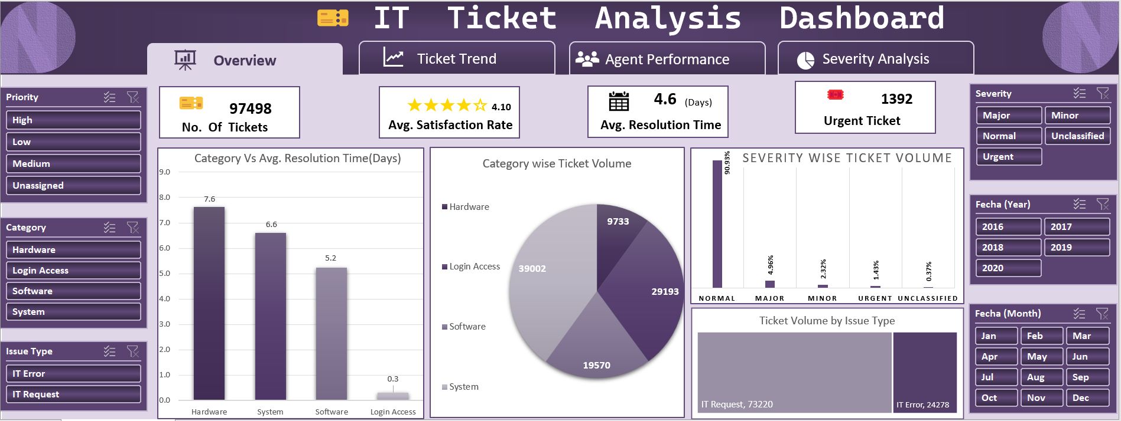
14

Slide 21
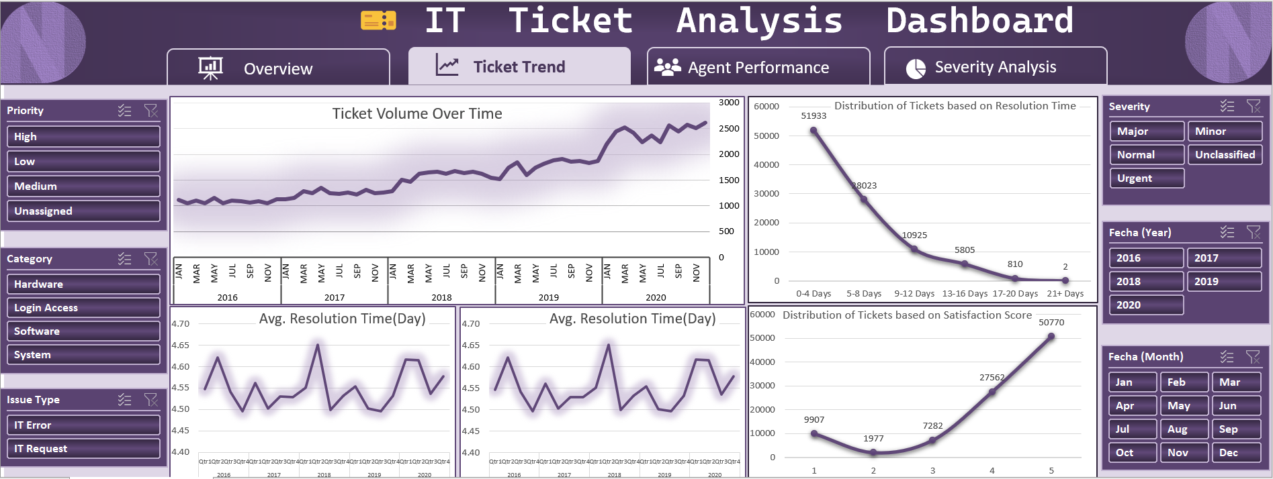

Slide 22
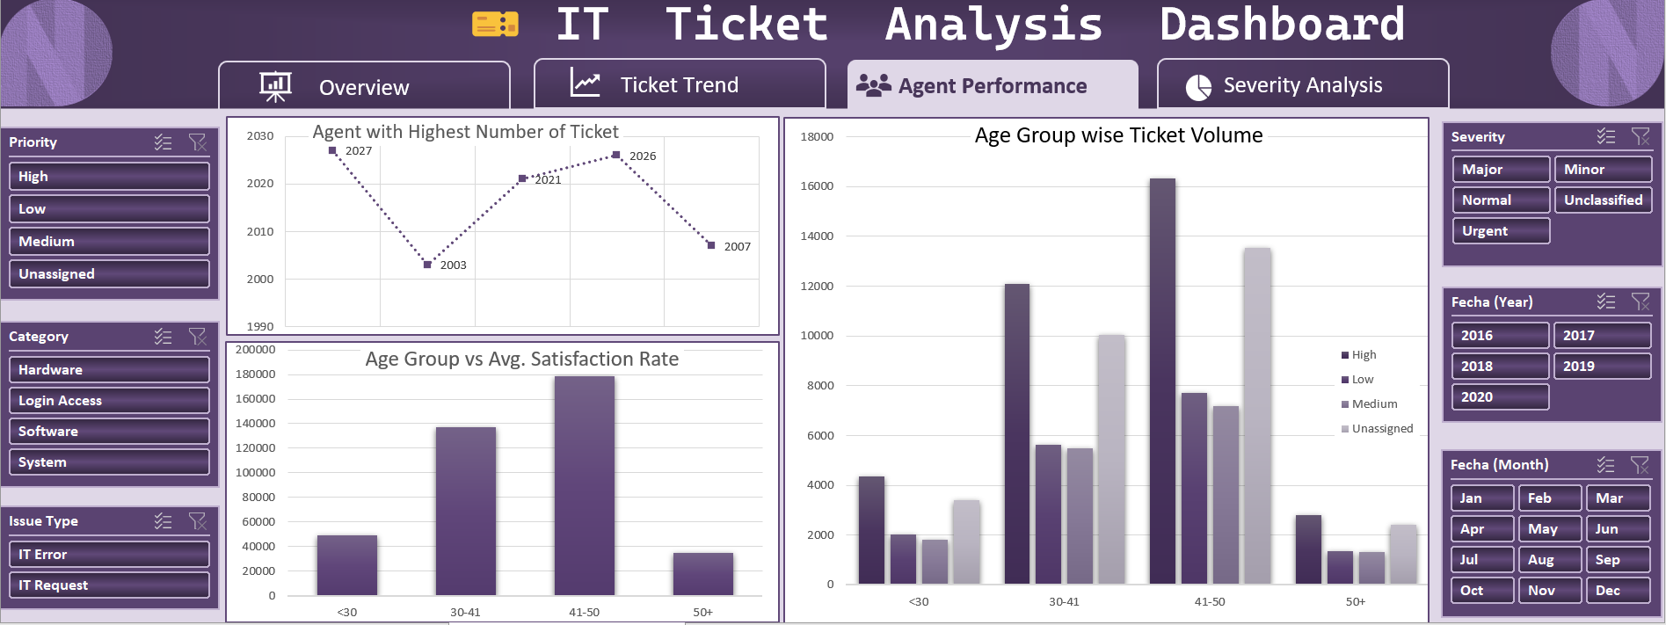

Slide 23
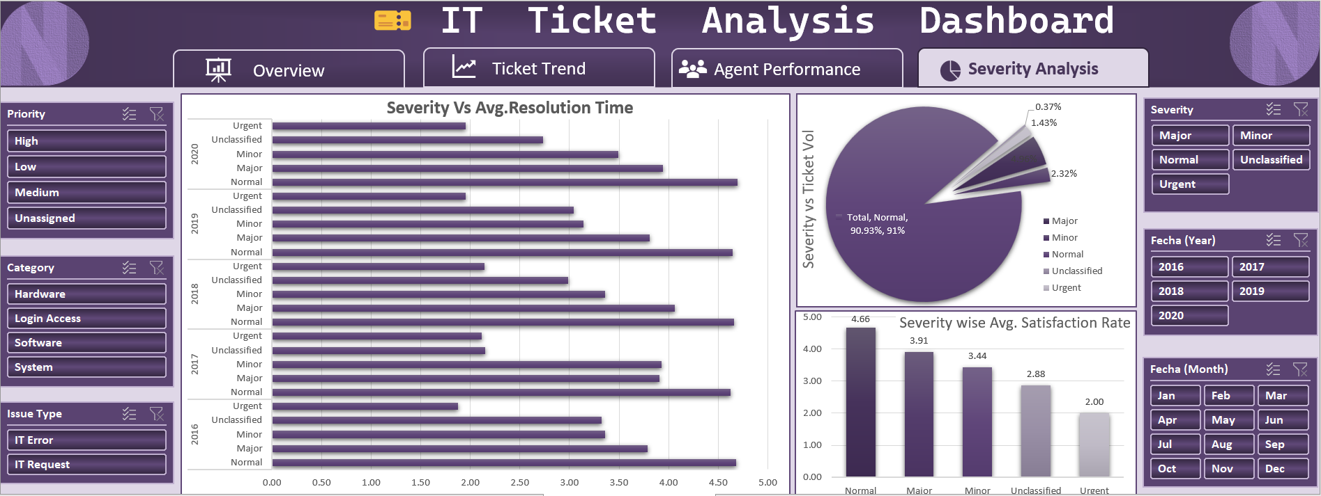

Slide 24
Key Metrics Summary
Conclusion
Key Takeaways:
Ticket Growth: Volume surged 123% (2016–2020) → calls for proactive capacity planning.
Agent Performance: Uneven results; training existing staff > hiring new agents.
Tech Impact: Post-2018 upgrades reduced resolution times noticeably.
Automation Scope: 70% of tickets (System & Login) → prime candidates for automation.
Ticket Growth: 123% increase (2016–2020) → peaked at 29,088 tickets in 2020
Category Mix: System (40%), Login (30%), Software (20%), Hardware (10%)
Performance Metrics: Avg Resolution = 4.6 days, Avg Satisfaction = 4.1/5
Agent Effectiveness: 41–50 age group = most efficient (Res. Time 3.99 days)
Recommended Actions:
Agent Training Program
Focus: Bottom performers (Agents 3, 6, 22, 28)
Implement Automation
Priority: Login Access & System tickets
Mentorship Structure
Using 41-50+ age group agents as guides
Project Summary:
Analyzed 97,000+ IT tickets over 5 years using Excel-based dashboard.
Identified key insights on support performance, agent efficiency, and process optimization.

Slide 25
Tools Used
Acknowledgements & References
Data Sources
Tickets Dataset:-
97,498 records with complete ticket meta data.
Source: Internal IT Management System
Microsoft Excel:
Primary platform for analysis & dashboard creation
PivotTables:
Powerful tool for aggregation & cross-tabulation
👤
Charts & Graphs:
Visualize trends and performance metrics
IT Agents Dataset:-
50 agents with demographic & performance data
Formulas Used:
AVERAGE, VLOOKUP, IF, INDEX/MATCH, TEXT
Special Thanks:-
Created By:-
Vijay Chandra Raj
for his Mentorship
Vaishnavi Pandey

